Slide 1
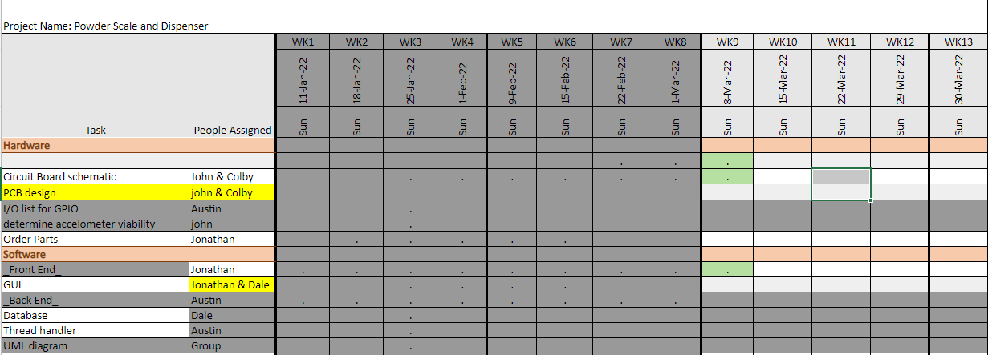
Week 8 (23-Feb to 1-Mar)

Slide 2
Week 8 (23-Feb to 1-Mar) Austin Stecklein
Goal/Task | % Done | Hours (Act.)
Merge backend & frontend | 10 | 5
Testing backend | 98 | 5
Ubuntu configuration | 50 | 16
Hours on task during the week (On track ≥ 13 / wk) | 16
Total hours on task so far this semester (On track ≥ 98 hrs) | 96

Slide 3
Progress made during the week (Log) (What I did)
Starting testing frontend on Beaglebone black
Finishing testing of backend with each process running on sperate threads
Configuring Ubuntu to function as desired. (i.e. auto start application, downloading libraries, and security config)

Slide 4
Difficulties encountered during the week (What I did not do and why)
Ubuntu configuration
Graphic operating system not running

Slide 5
Goals for this coming week (Ones that move the project forward the most)
Goal/Task | Stop Date (Est.) | Hours (Est.)
Get graphic operating system to run | 3/9 | 2-4
Start testing Frontend | 3/9 | 5
linking frontend and backend functionality | 3/15 | 6
Estimated time needed to work on goals for this coming week (typ. 13 hrs) | 13

Slide 6
Week 8 (23-Feb to 1-Mar) Colby Hatton
Goal/Task | % Done | Hours (Act.)
PCB Layout | 80% | 15
Hours on task during the week (On track ≥ 13 / wk) | 16
Total hours on task so far this semester (On track ≥ 98 hrs)

Slide 7
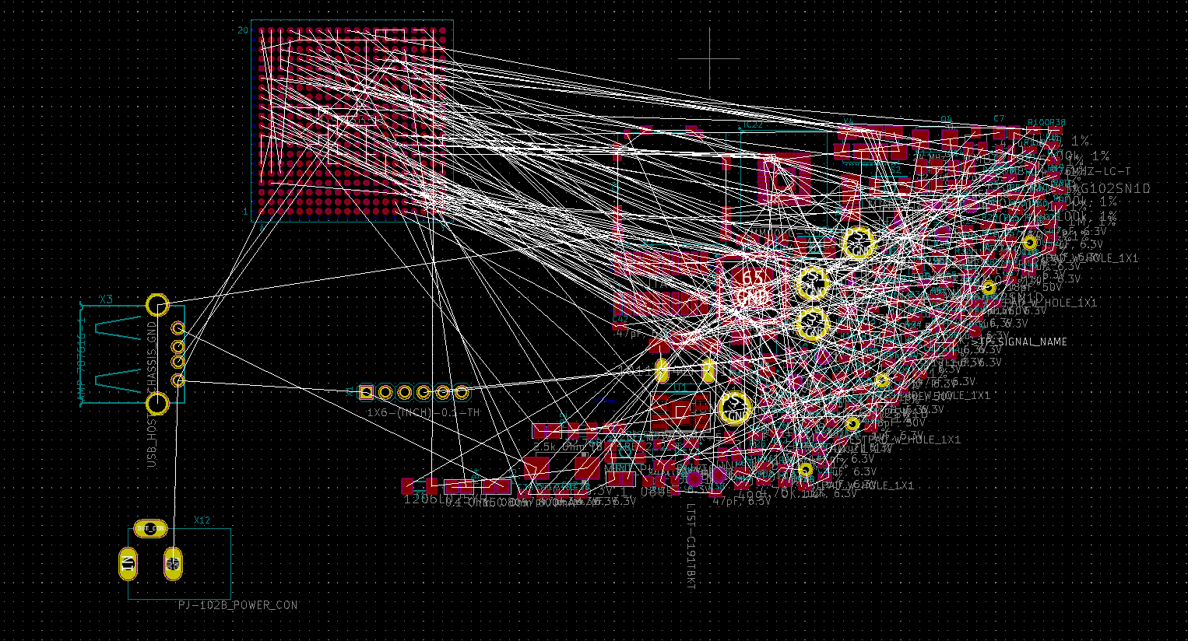
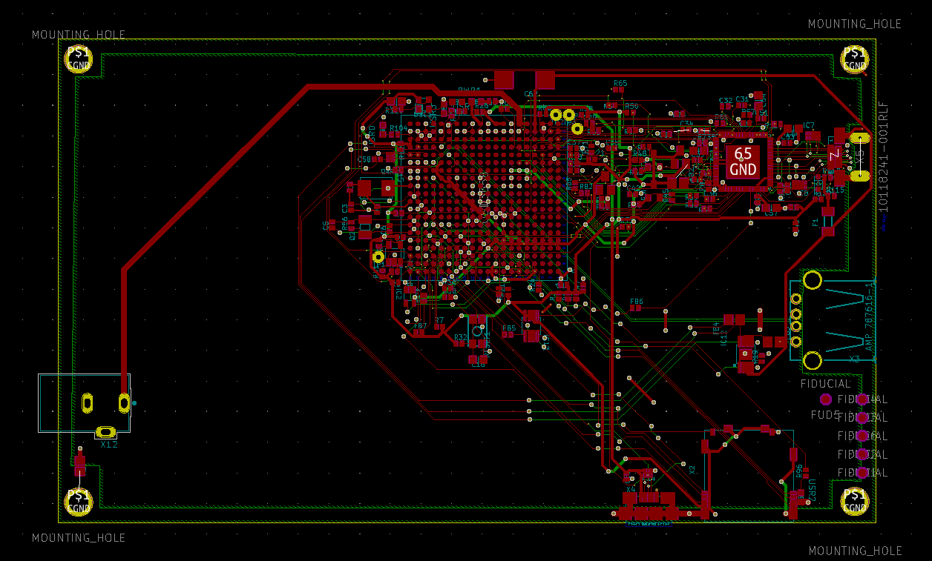
Progress made during the week (Log) (What I did)
Laid out and routed nearly the entire board. Power components are all that remains.
Before
After

Slide 8
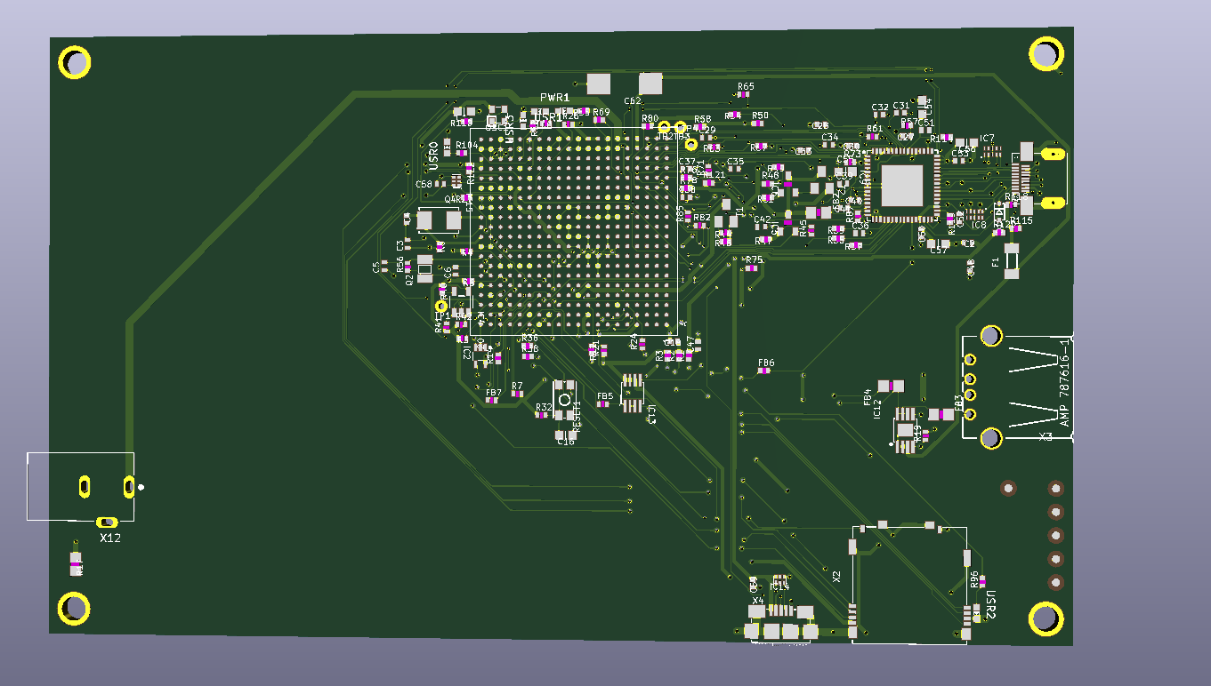

Slide 9
Difficulties encountered during the week (What I did not do and why)
Ran out of Audiobook. Routing takes a long time.

Slide 10
Goals for this coming week (Ones that move the project forward the most)
Goal/Task | Stop Date (Est.) | Hours (Est.)
Route Power components. | 3/9 | 5
Determine how to split project across multiple accounts | 3/3 | 1
Estimated time needed to work on goals for this coming week (typ. 13 hrs)

Slide 11
How can we help you achieve your goals?
Be ready to answer questions about lines, signals, and pins.

Slide 12
Week 8 (23-Feb to 1-Mar) John Stinger
Goal/Task | % Done | Hours (Act.)
Board Development | 80% | 6
Price Estimate | 100% | 2
Other |  | 3
Hours on task during the week (On track ≥ 13 / wk) | 11
Total hours on task so far this semester (On track ≥ 98 hrs) | 83

Slide 13
Progress made during the week (Log) (What I did)
For example: Resources found (links, manuals), Designs created, Decisions made and corresponding rational, Photos of prototype progress, etc.
Helped develop the board
Made a price estimate for the project

Slide 14
Difficulties encountered during the week (What I did not do and why)
Most of the components are going to be in the board cost

Slide 15
Goals for this coming week (Ones that move the project forward the most)
Goal/Task | Stop Date (Est.) | Hours (Est.)
Continue Board Development |  | 10
Estimated time needed to work on goals for this coming week (typ. 13 hrs)

Slide 16
Week 8 (23-Feb to 1-Mar) Johnathan Philips
Goal/Task | % Done | Hours (Act.)
Front End – Implementation of Images as Buttons | 95 | 2
Front End – Working on the other Pages | 42 | 5
Front End – General Progression | N/A | 2
Hours on task during the week (On track ≥ 13 / wk) | 11
Total hours on task so far this semester (On track ≥ 98 hrs) | 86

Slide 17
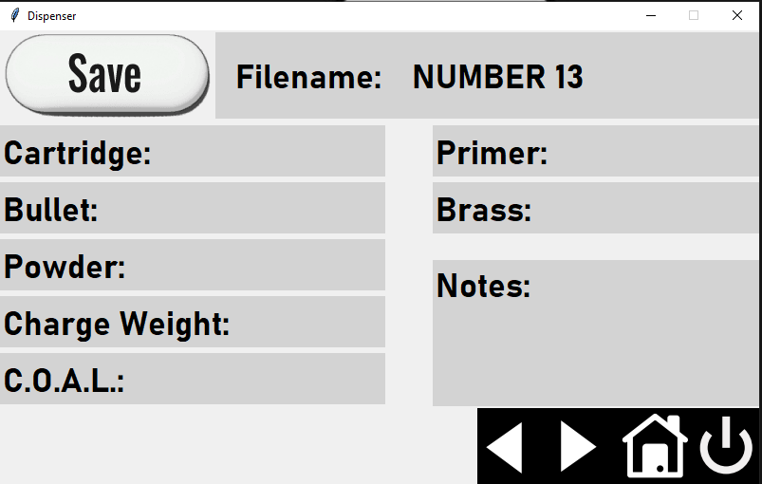
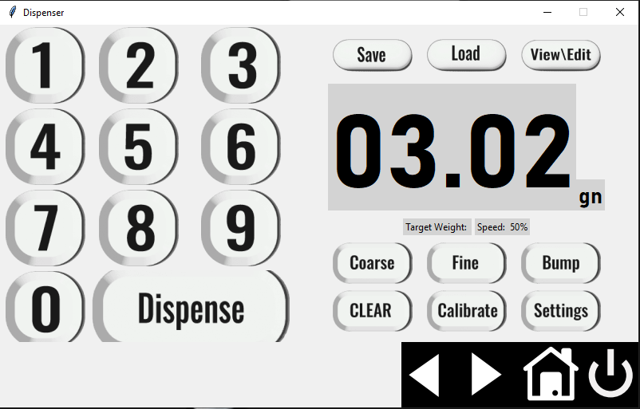
Progress made during the week (Log) (What I did)

Slide 18
Difficulties encountered during the week (What I did not do and why)
Receiving input from user and storing new value

Slide 19
Goals for this coming week (Ones that move the project forward the most)
Goal/Task | Stop Date (Est.) | Hours (Est.)
Front End – Save Card Screen and Unit Change on Home Screen | 3/9/22 | 7
Front End – Receiving input from user | 3/9/22 | 4
Front End – General Progression | 4/6/22 | 2
Estimated time needed to work on goals for this coming week (typ. 13 hrs) | 13

Slide 20
Week8 (23-Feb to 1-Mar) - Dale Andreoli
Goal/Task | % Done | Hours (Act.)
Finish Save screen skeleton | 100 | 4
Finish Settings screen and sub screens skeletons | 100 | 7
Implement Pages in the Load screen |  | 2
Project Objective / Mission Statements
Power Scale Dispenser:
Design, build, and test the electronics for the dispenser with a touch screen display and controlling two stepper motors by April 6, 2021 with a prototyping budget of $1000 USD and for less than 600 people-hours.
Hours on task during the week | 13
Total hours on task so far this semester | 96

Slide 21
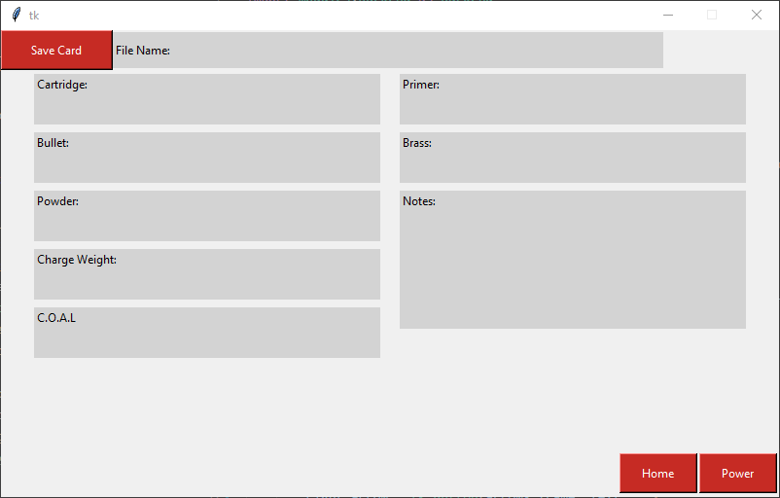
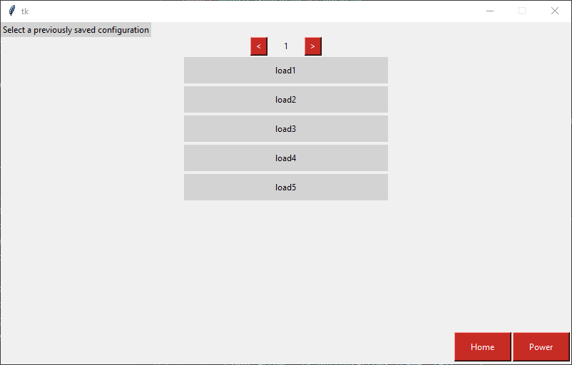
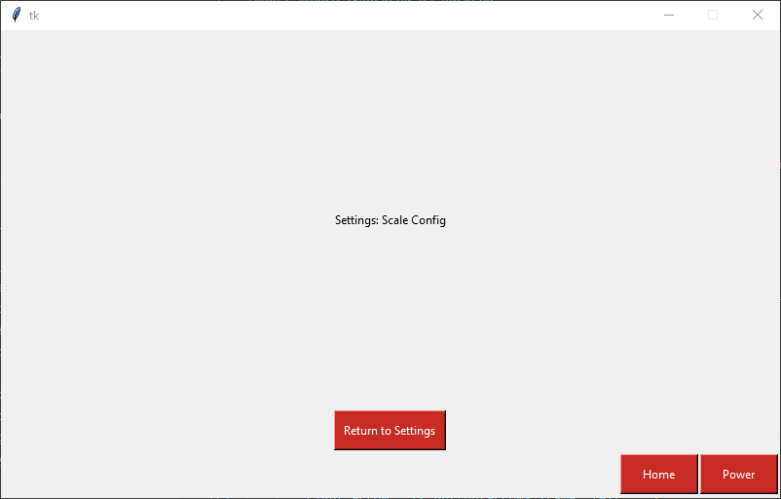
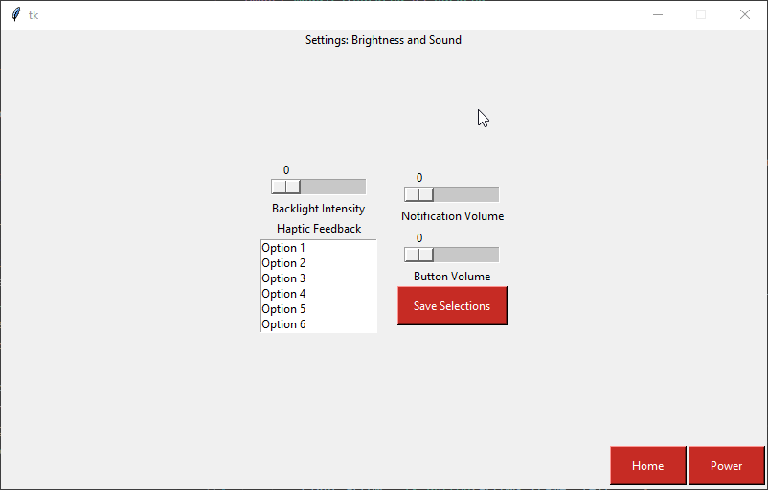
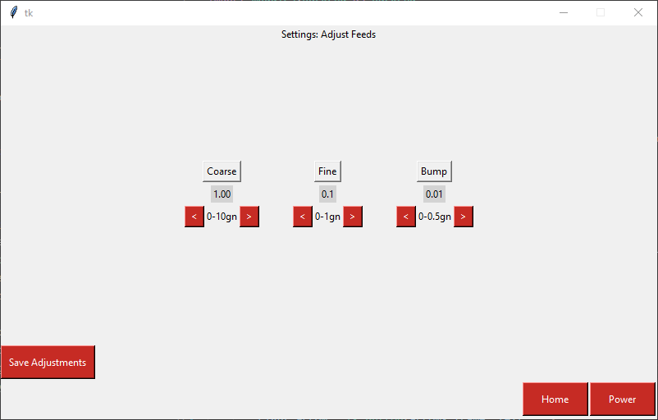
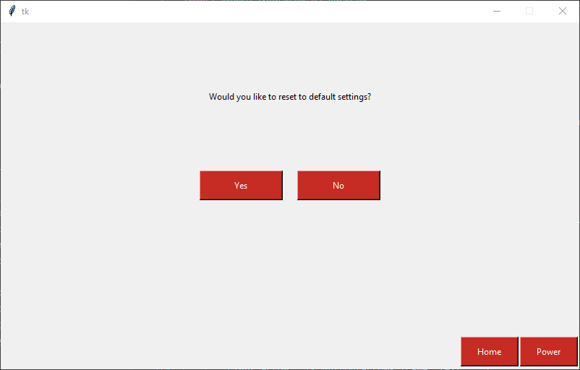
Progress made during the week (Log) (What I did)
Finished settings pages
- Brightness/sound, Feed Adjustments, Default
Finished Save page
Started making pages for the
Load screen

Slide 22
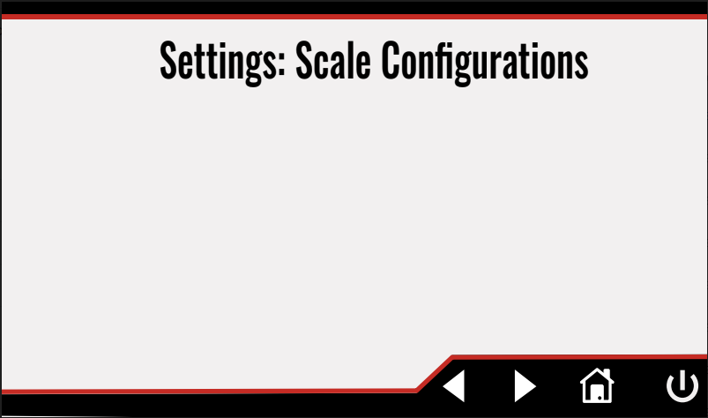
Difficulties encountered during the week (What I did not do and why)
What should be happening in the Scale Config page?

Slide 23
Goals for this coming week (Ones that move the project forward the most)
Goal/Task | Stop Date (Est.) | Hours (Est.)
Collaborate with Jonathan and Austin – connect UI to backend – get UI looking as designed |  | 3
Finish Load screen pages module |  | 6
Start View page once a similar solution is arrived at in the Load page |  | 4
Estimated time needed to work on goals for this coming week | 13

